Slide 1

An Overview of the
Conceptual Architecture of
presented via a video summary

Slide 2
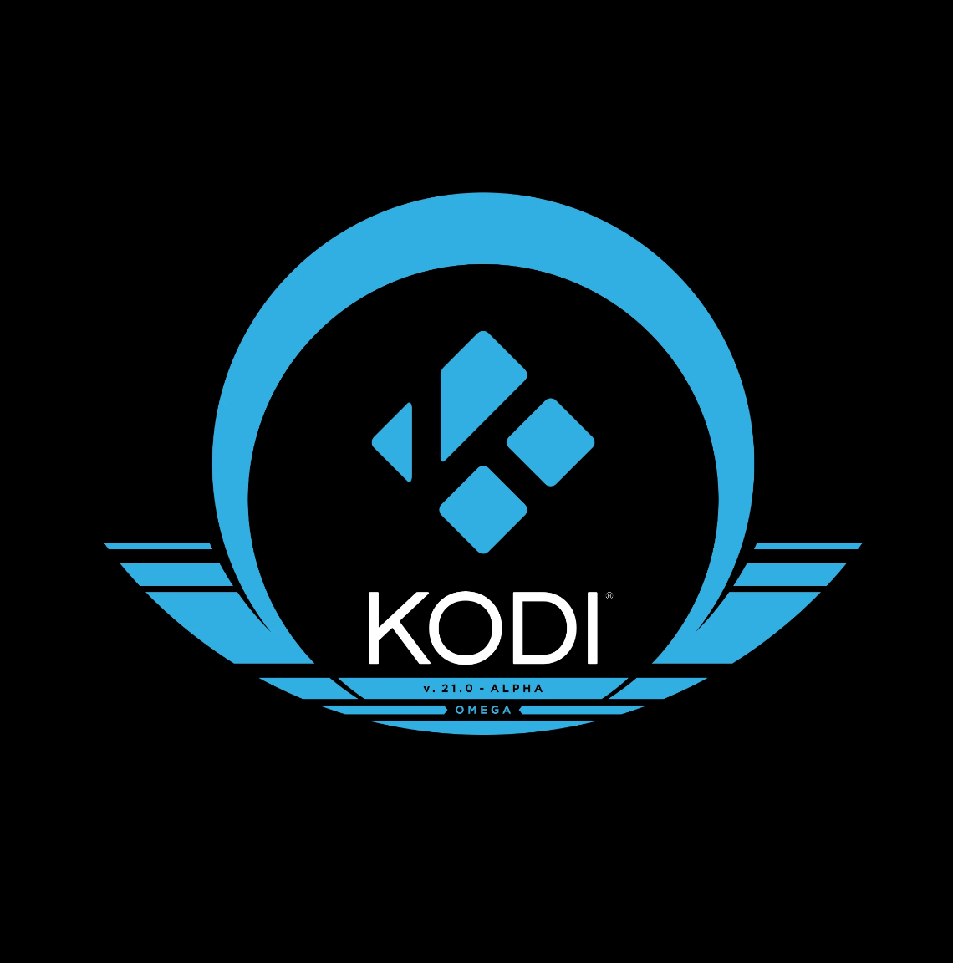
Team Members & Contributions
Kabeer Adil
Nicholas Tillo
Group leader
Abstract, Introduction
Presenter
Slides, Conceptual Architecture
Kate Edgar
Raksha Rehal
External Interfaces,
Use Cases
Presenter
Voiceover, Conceptual Architecture
Xiyun Cao
Yu Xuan Liu
Data Dictionary,
Naming Conventions
Conclusions,
Lessons Learned

Slide 3
01
INTRODUCTION

Slide 4
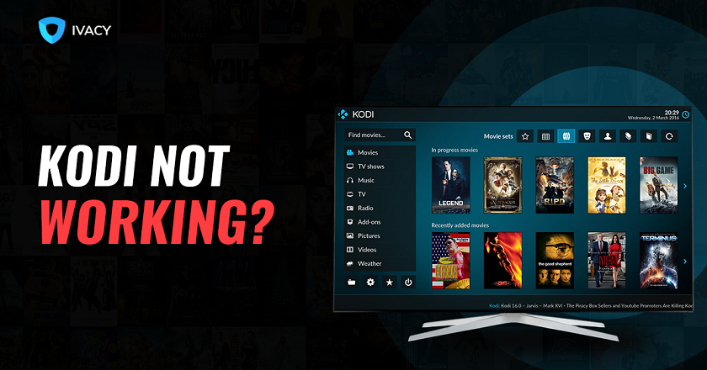

WHAT IS KODI?
Open-source multimedia entertainment platform
Utilizes C++ and Python
Supports third-party applications e.g. YouTube, Spotify, Hulu, etc.
Notes:
XBMC Foundation initially crafted KODI as the ultimate entertainment hub, encompassing films, games, TV shows, and music. The source code, unveiled in June 2012, has since undergone perpetual expansion and enhancement. To fortify its multifaceted approach, the Kodi Media Player employs C++ and Python to allow plugins supporting various add-ons and third-party software like Spotify, Hulu, or YouTube.
In the program's backend, numerous software engineers, testers, and architects collaborate incessantly to refine KODI's source code. A closer look at key stakeholders reveals that only a select few developers wield the authority to approve or reject code contributions and pull requests. This privilege is earned through a substantial number of commits to the Git, symbolizing a profound commitment to the ongoing enhancement of KODI.

Slide 5
02
REQUIREMENTS & FUNCTIONALITIES

Slide 6
FRs & NFRs
FUNCTIONAL REQUIREMENTS
NON-FUNCTIONAL REQUIREMENTS
Versatility with media formats.
Allow for portability without sacrificing performance.
Media Player:
GUI, Image Display, Music/Video
Libraries:
Media Storage, Rendering Engines, Add-Ons/Plugins, Webscrapers
Scalability: varying file sizes
Integration: allow for third-party add-ons
Portability: functional across various operating systems, data file formats
Testability: aid in testing modules on their own & modules working together
Notes:
In order to derive Kodi’s conceptual architecture, we must first determine what the functional requirements for Kodi must have been. Upon studying the documentation and the current concrete architecture of KODI , we can see that its objective revolves around serving as a versatile media player, distinguishing itself from traditional players that are generally confined to a single media format. Consequently, a pivotal demand placed on KODI is to prioritize portability without compromising performance.
Hence, we are able to notice that these requirements fall under the two categories of media player, and libraries:
Media player encompass a spectrum of functionalities catering to user interactions in content exploration and access. This includes graphic interfaces, image display, music and video playback, streaming, and the ability to customize skins.
On the other hand, libraries focus on tasks associated with the aggregation, storage, and upkeep of entertainment content. This involves functions such as storage management, rendering, sorting, add-ons, and web scrapers.
NFRs
We can further evaluate quality metrics that Kodi meets in order to aid us in determining the best way to model the system’s conceptual architecture. Specifically, we can observe the following attributes…
Scalability is crucial for KODI due to its multimedia nature, necessitating the ability to adapt to an expanding array of file types and sizes. From small audio files to lengthy video files, KODI must seamlessly support diverse formats.
Integration plays a pivotal role, shaping the core functionality through the creation of custom add-ons for various file sharing needs. This design choice influences the architecture, demanding flexibility to accommodate additional space for third-party components. This, in turn, promotes a modular design, facilitating easier grouping, access, and adjustment of subsystems.
Portability is integral to KODI's design, enabling operation on a range of devices, from standard Windows or Linux PCs to Apple hardware and beyond. The system's versatility extends to supporting various multimedia formats, including containers, videos, audios, images, and subtitles.
Testability is a critical consideration, given KODI's development by independent developers with limited structure and documentation. The architecture must aid developers in pinpointing and resolving issues within the code efficiently.

Slide 7
03
DERIVATION PROCESS

Slide 8
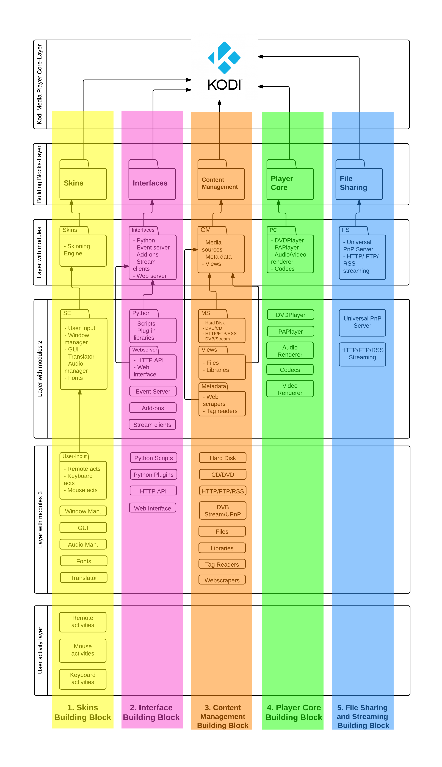
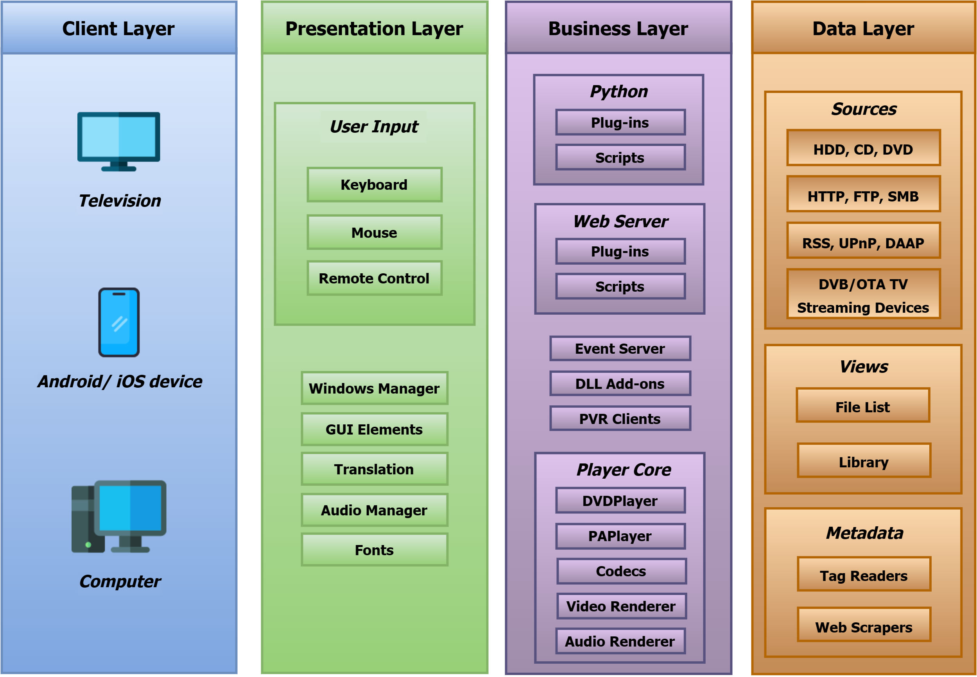
Figure provided by the official KODI wiki
Figures demonstrating the layered (columns) structure of KODI’s concrete architecture.
Components also seem to be grouped by functionality, indicating modularity.
Figure provided by an analysis of KODI’s a
architecture from a development viewpoint
Notes:
Upon examining KODI's functionality and assumed requirements, as well as extrapolating insights from its concrete architecture, it becomes apparent that the system adopts a blend of modular and layered architectural styles. KODI incorporates multiple distinct modules, each addressing different categories of operations and limiting communication outside their module to the topmost level. This configuration ensures easy replacement of components, high-level additions, and standalone usability—an alignment that satisfies the integration and testability requirements.
Moreover, these modules follow a layered design, facilitating clear interaction distinctions and minimizing dependencies that could hinder the desired modular structure. This layered approach provides the necessary structure, contributing to the required scalability and portability of the system mentioned earlier.

Slide 9
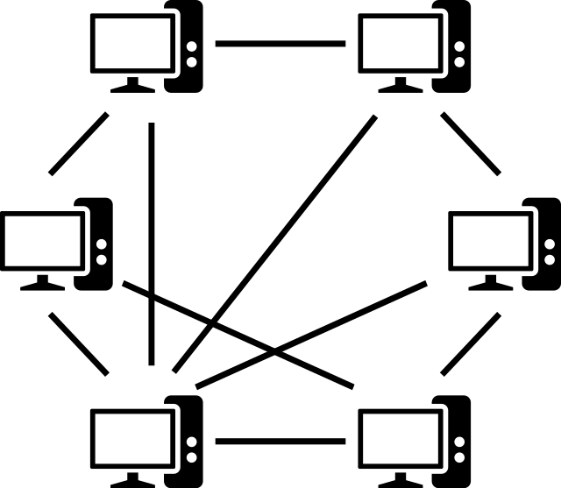
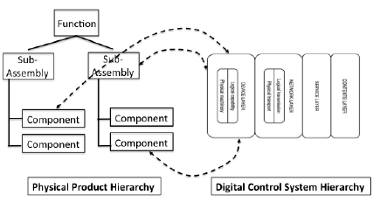
CONSIDERED ALTERNATIVE
Modular Layered Architecture vs. Peer-to-Peer
Notes:
The main alternative we considered was a peer-to-peer style, as we believed that the modularity of Kodi’s functions could be well-encapsulated within separate components that all interact with one another by providing their respective services. The reason we rejected this alternative is due to the layered structure that we noticed was present in Kodi’s concrete architecture. We observed that the modules were organized in layers, where each lower layer dealt with lower-level processes. We also noticed that these sections did not interact with non-adjacent sections, leading us further to determine that this was a layered, modular architecture as opposed to a peer-to-peer style.

Slide 10
04
CONCEPTUAL ARCHITECTURE

Slide 11
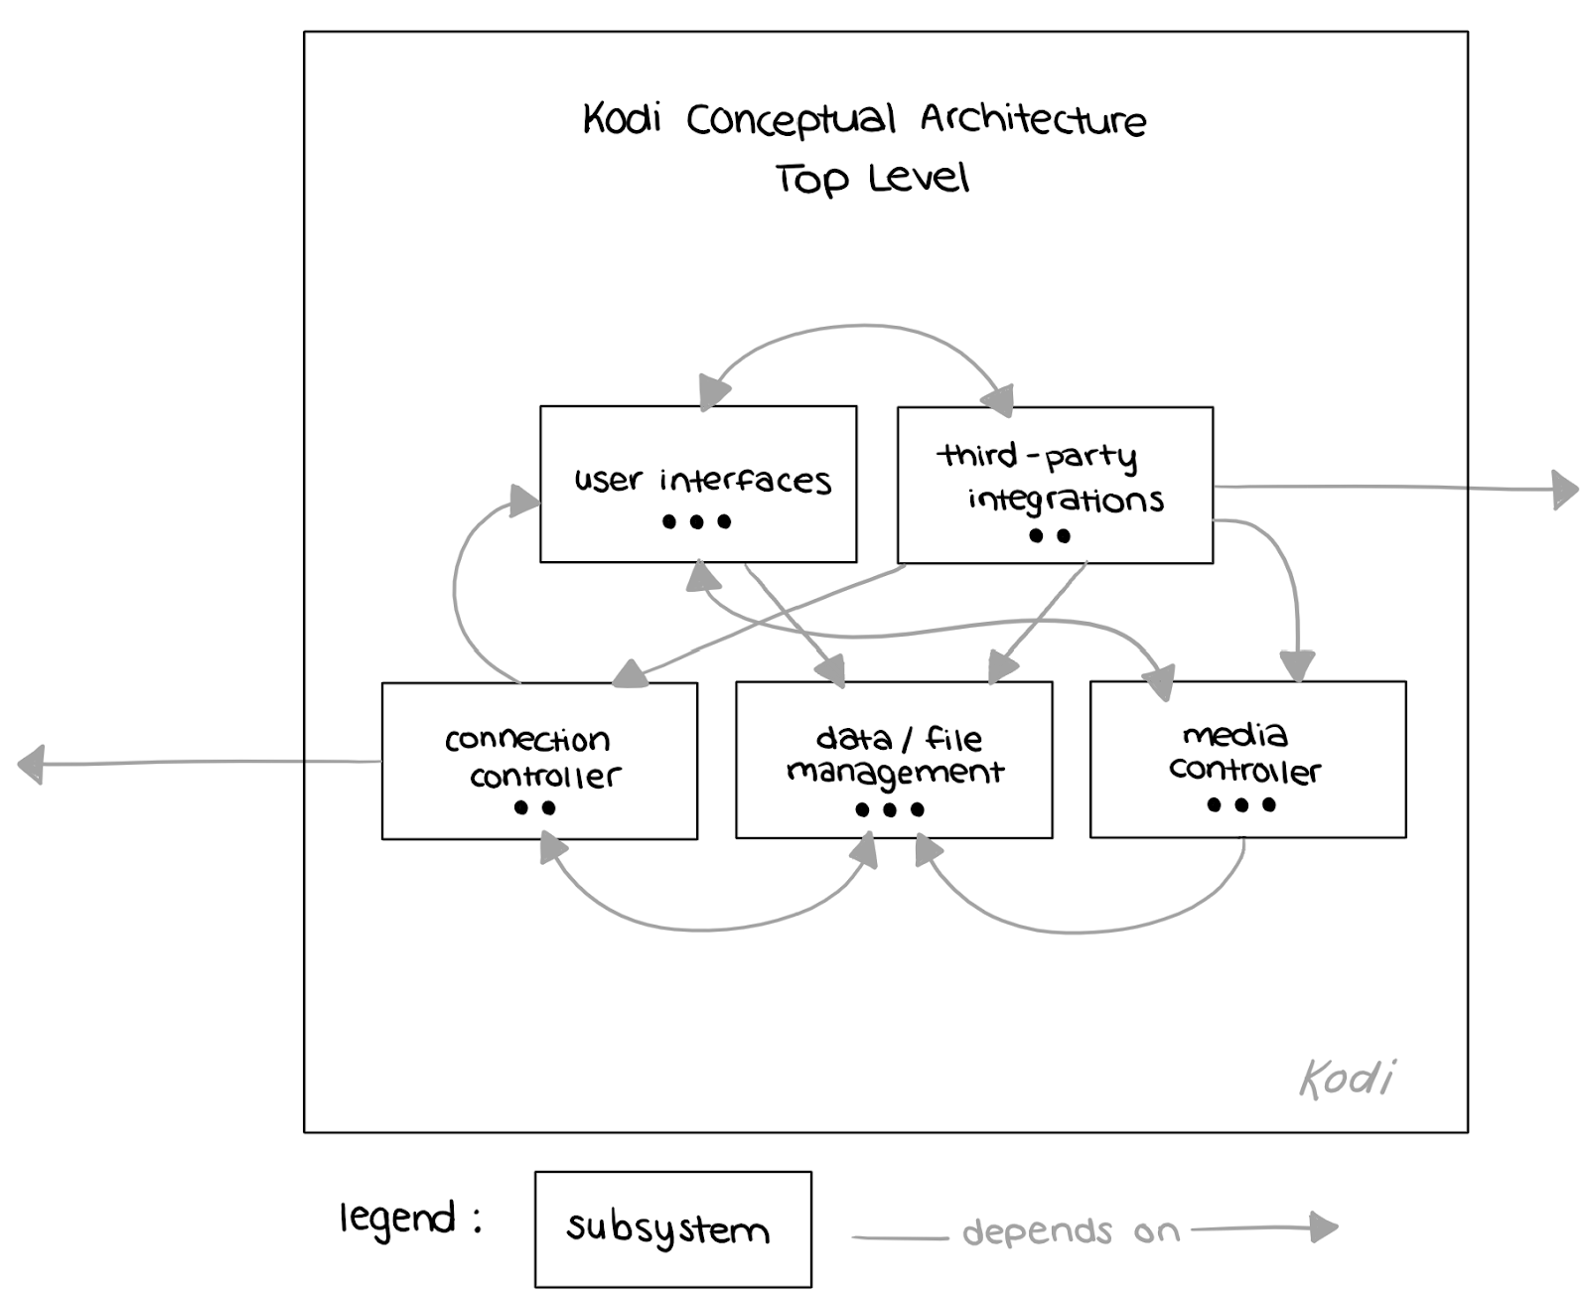
TOP LEVEL
USER INTERFACES
THIRD-PARTY INTEGRATOR
MEDIA CONTROLLER
DATA/FILE MANAGEMENT
Visual appearance & interactive aspects
Supports integration of external software
Processes, renders and displays media
Stores media files and associated data
CONNECTION CONTROLLER
Allows streaming from external sources
Notes:
Having determined the appropriate architectural styles that best models Kodi as a system and satisfies its functional and non-functional requirements, we group components by the services they provide in order to find an architecture that works at the highest level of abstraction.
This diagram displays the major components and interactions that happen at the top level of implementation within the Kodi system.
The User Interfaces component encompasses the interfaces that constitute the visible and interactive parts of the system, defining KODI's appearance and handling user input.
The Third Party Integrator manages events from external sources that impact or work with the application's features.
The Media Controller is tasked with rendering and displaying various of the media types available within KODI.
Data/File Management oversees the collection and storage of media files and related data, including the files, metadata, and external libraries.
The Connection Controller facilitates streaming and connection services that KODI can provide through external sources and web connections.

Slide 12
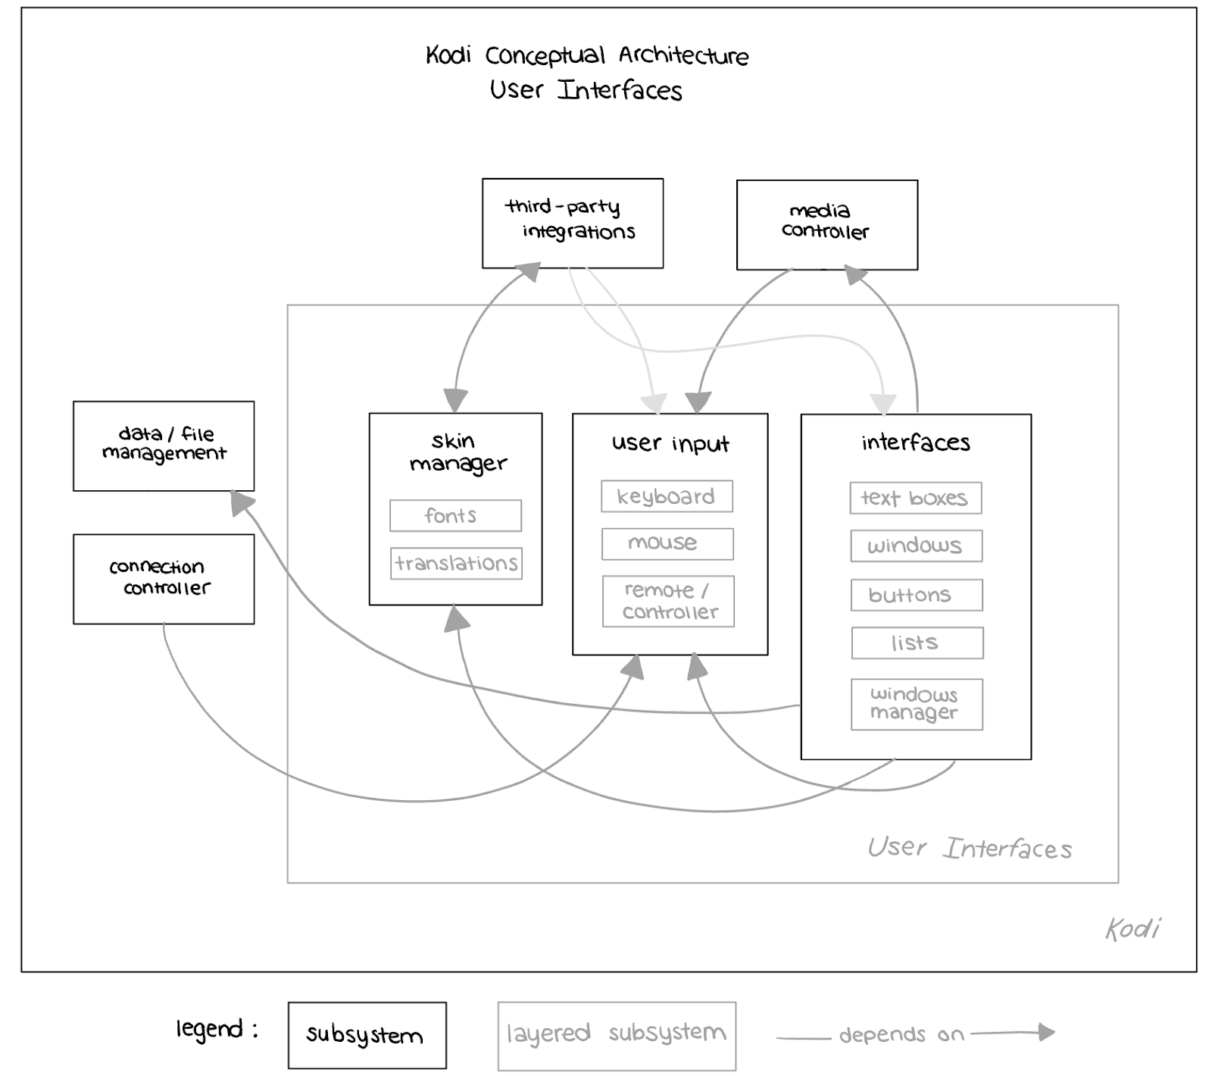
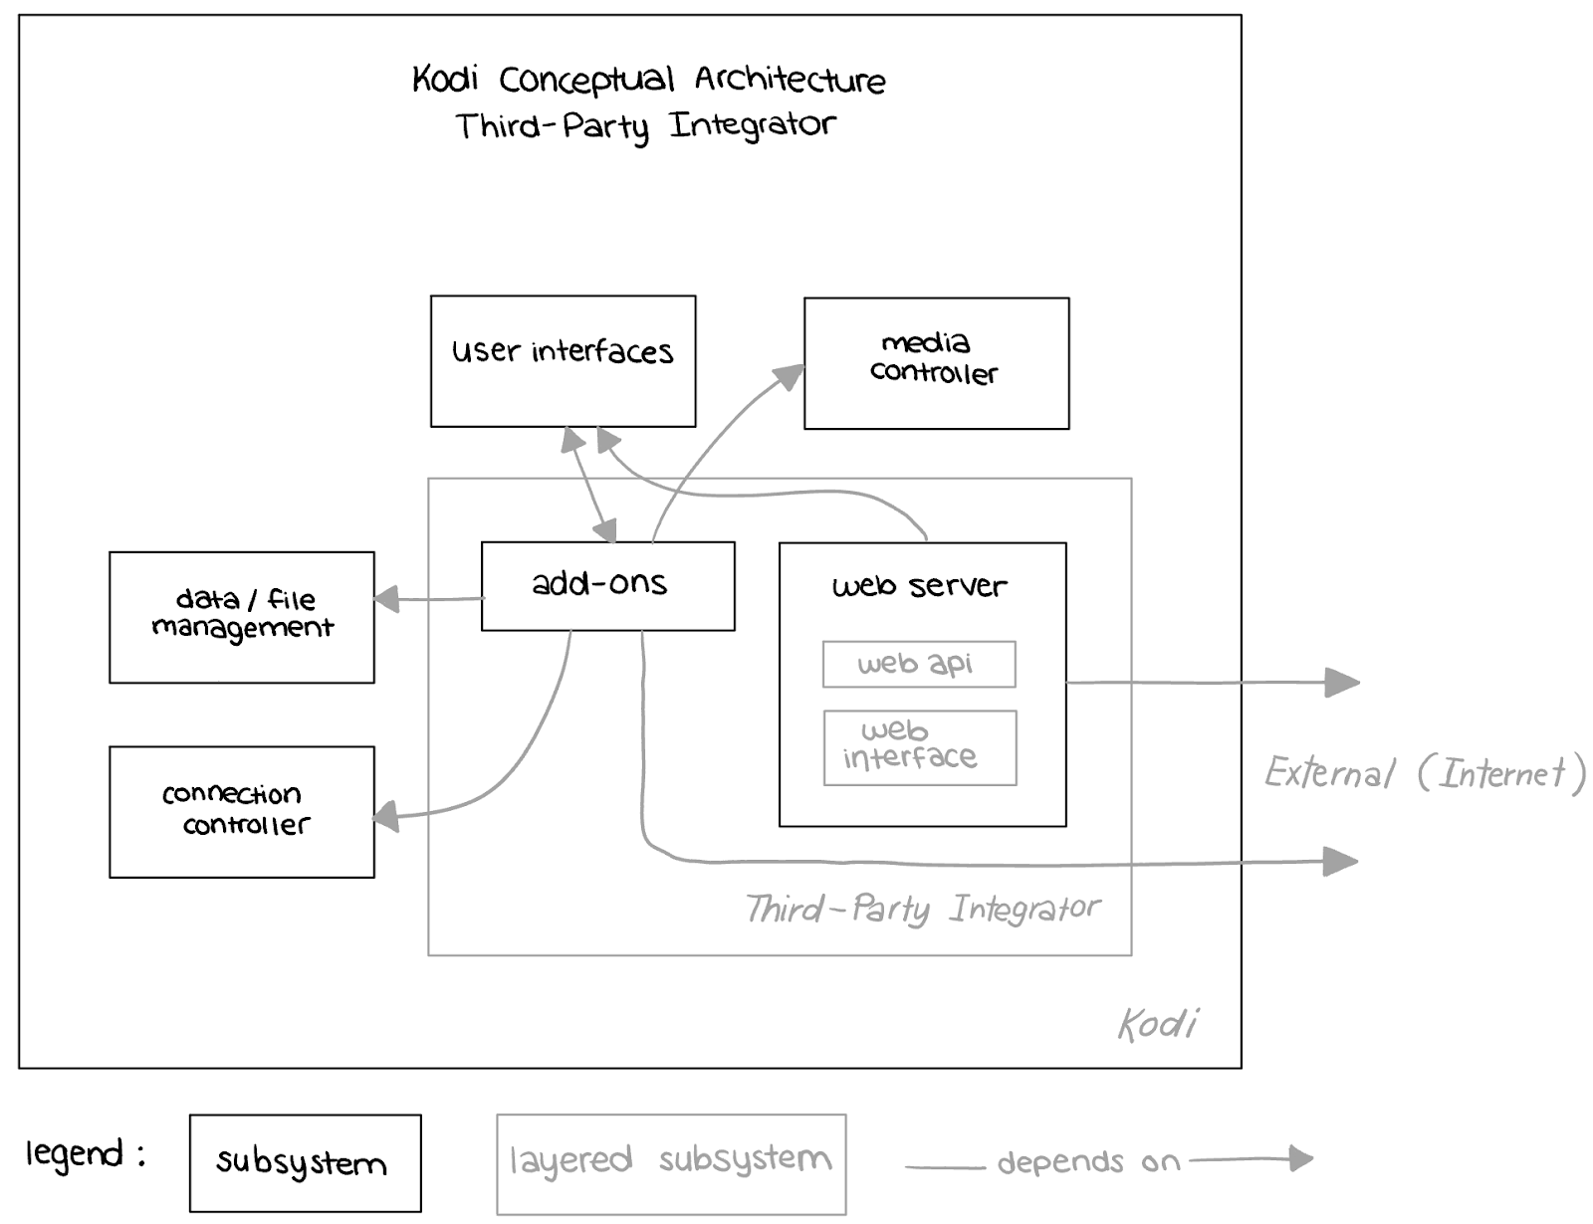
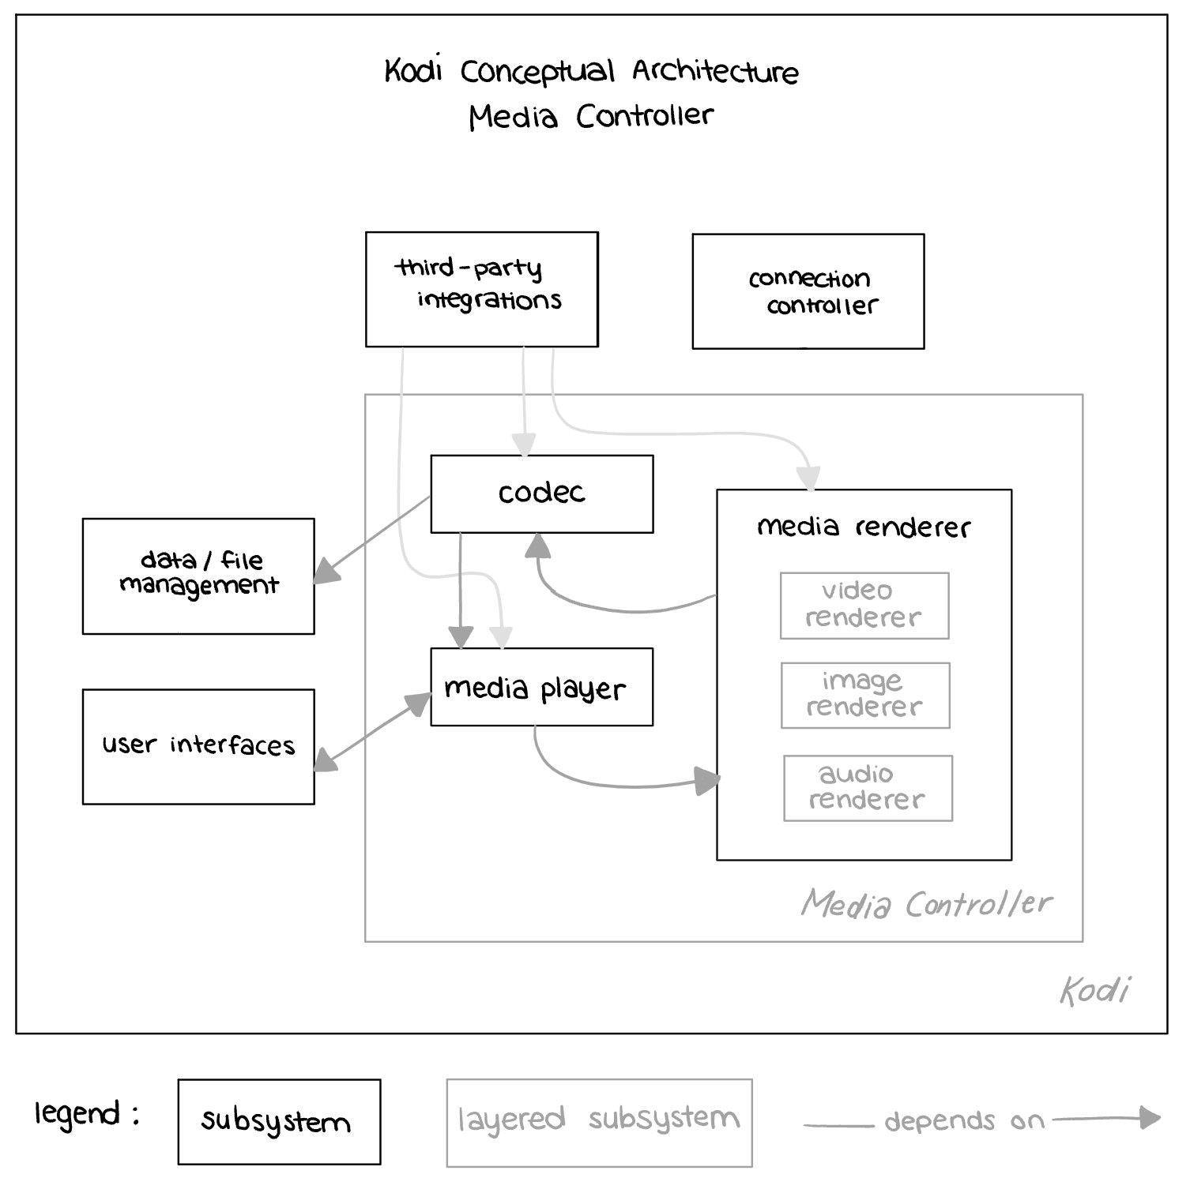
INTERACTIONS AT THE TOP LEVEL
Notes:
The User Interfaces component relies on the Third-Party Integrator, drawing on addons created specifically to shape the interface to the user’s desires. Additionally, it depends on the Media Controller for rendered media to display and on the Data/File Management for organizing and sorting media data in a user-friendly manner.
The Third-Party Integrator, in turn, depends on all other components, managing addons that rely on functions from these components. It relies on external sources mainly, in order to receive these add-ons from developers who wish to add to or manipulate the other components of the KODI system to boost accessibility to users.
The Media Controller primarily functions within itself to decode and render media. However, it depends on the Data/File Management component to provide raw encoded data of the media that the user wishes to interact with. Furthermore, it relies on User Interfaces for user input to determine the desired media and an interface to output the media to.

Slide 13
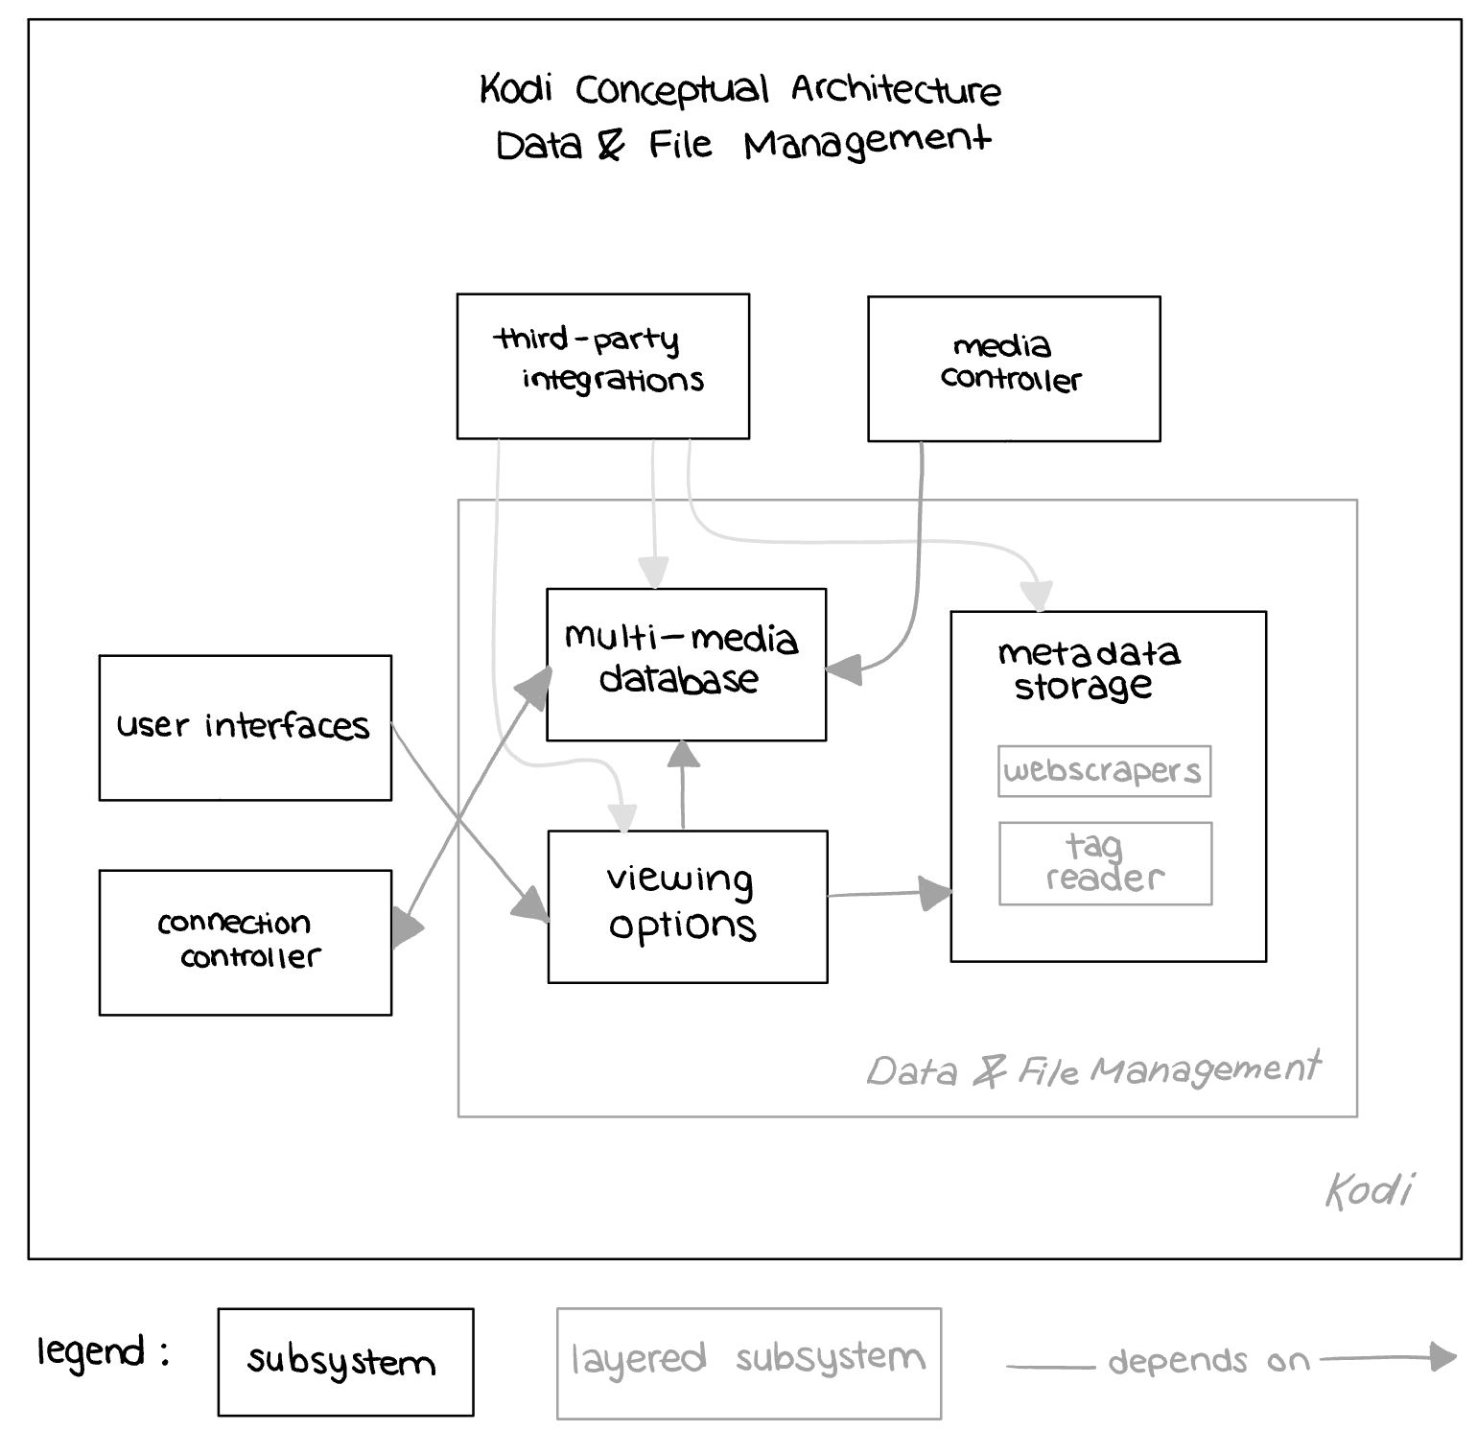
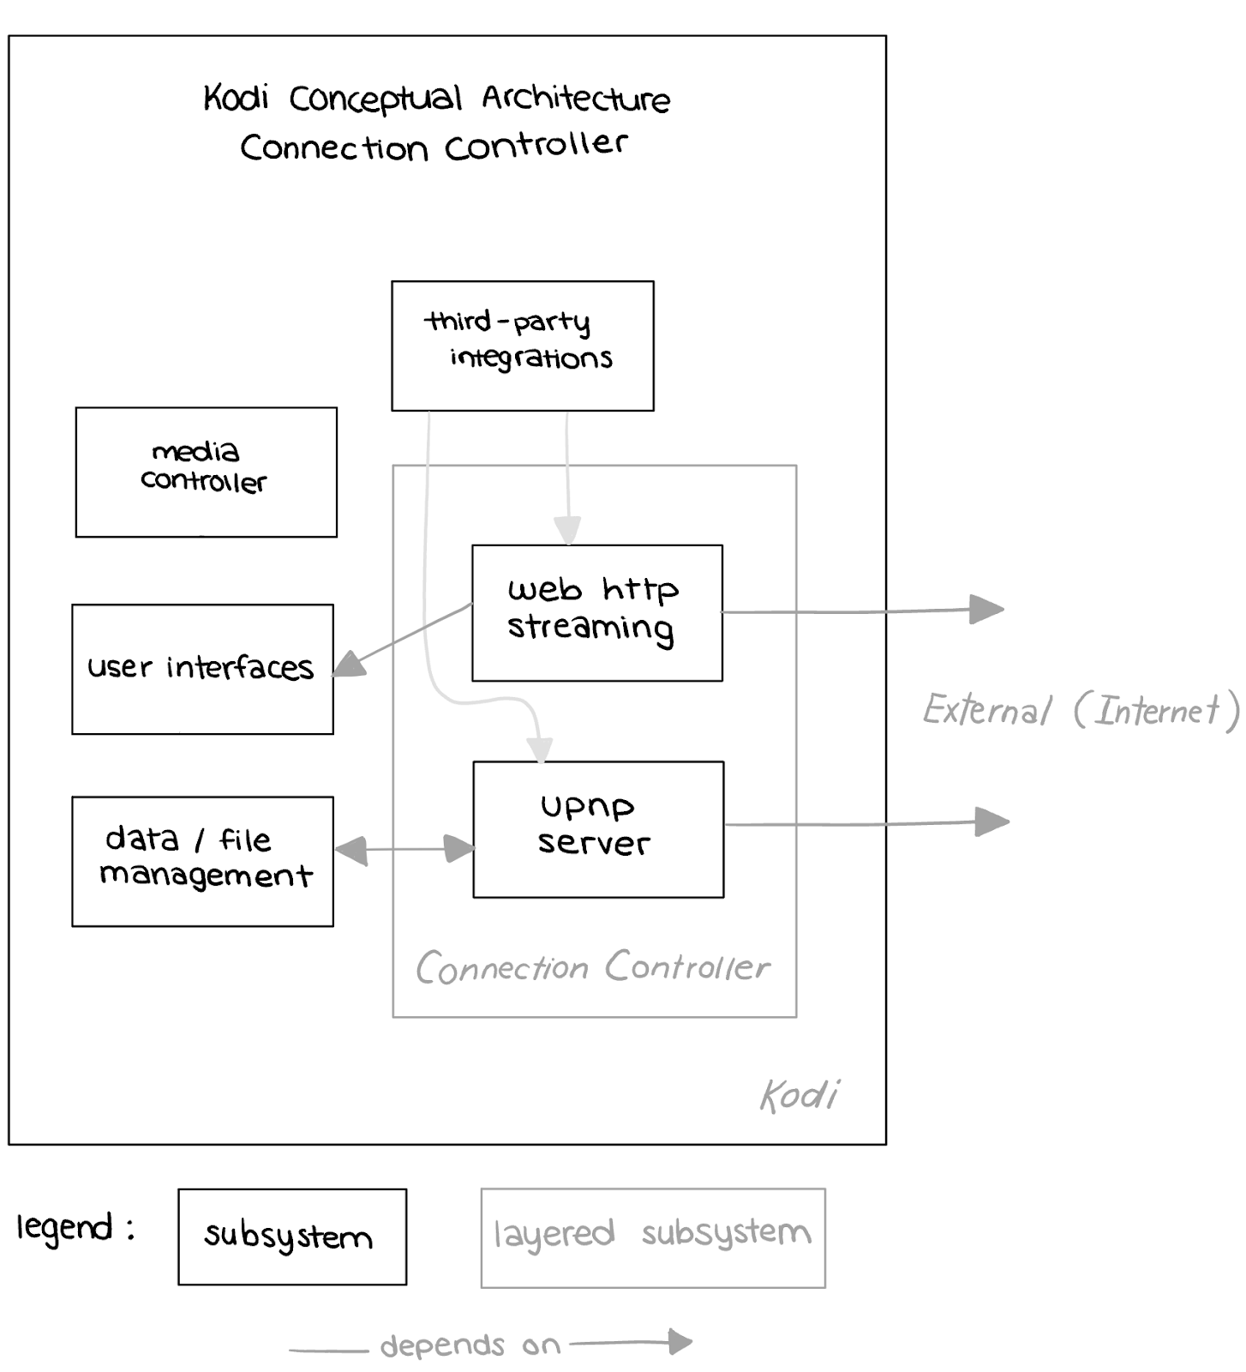
INTERACTIONS AT THE TOP LEVEL (CONTINUED)
Notes:
The Data/File Management component depends on the Connection Controller for data to store. Internal dependencies include a metadata storage space and viewing options for effective data organization.
The Connection Controller relies on external sources for data and multimedia streaming via KODI. It also depends on User Interfaces for streaming and on the Data/File Management to have data for file sharing functionality.

Slide 14
05
CONCURRENCY & DATA FLOW

Slide 15
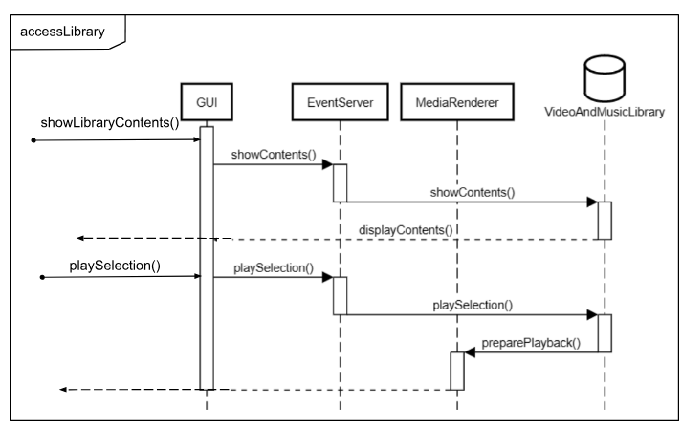
DICUSSION WITH USE CASE EXAMPLE
Prioritizes concurrency for swift load times
E.g. JSON-RPC API, the HTTP transport handles response and file downloading concurrently & TCP transport managing response and notifications
Segregates components into distinct groups, substantial interaction primarily at top layer
Sequence diagram demonstrates user input flowing between modules at top abstraction level
Notes:
Concurrency is a key focus in KODI's development, aiming for fast load and boot times to enhance end-user perception. The software architecture incorporates elements that enable multiple tasks and processes to run in the background simultaneously without the user's awareness.
In terms of data flow, The components are clearly separated into the five established groups, particularly in the lower layers of implementation where data flow mostly occurs within the confines of each component. However, a notable exception arises at the uppermost layer, where these groups can engage in interactions, invoking each other and external sources. For instance, the Media Renderer, positioned beneath the top level, is limited to interactions with the layers below and above it. However the Media Controller, residing within the top level, can engage with other components, fostering broader interactions within the system.
This concept is displayed in the use case diagram displayed here, showing how user input is able to be passed between modules on the highest level of abstraction.

Slide 16
06
CLOSING POINTS

Slide 17
MODULARITY
LAYERING
LESSONS LEARNED
Enhanced functionality
Portability & Scalability
Easily maintained
Easy to contribute to
Modifiability
High levels of security
Ease of access
Aids testing & debugging
Interoperability
Notes:
KODI's software architecture teaches us valuable lessons about the significance of choosing the right architectural style for a system. Two core principles stand out in our exploration of KODI's architecture:
Firstly, the emphasis on modularity is evident in KODI's design. The organization of components into modules enables users to enhance functionality by installing various add-ons and plugins. This directly supports KODI’s portability goals, and also allows the system to be contributed to and accessed easily.
Secondly, KODI organizes its modules into different layers, which makes the codebase highly modifiable. This allows KODI to compile and run seamlessly even if a non-essential module or library is disabled or removed. This modifiability is especially crucial for an open-source project like KODI, enabling simultaneous development without adversely affecting other parts of the system.

Slide 18
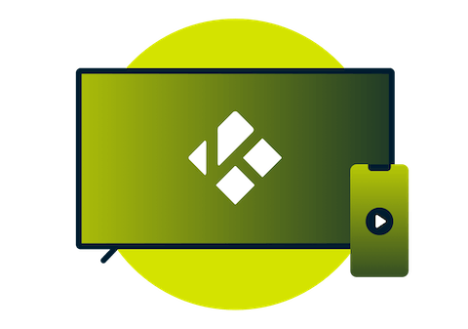
POTENTIAL LIMITATIONS
Complications managing module dependencies
Fallbacks in performance upon added modules
Decentralized layout may lead to coordination issues
Developers struggling to grasp the complex modular-layer architectue
Compatability issues between modules and add-ons / add-ons and different OSs
Lack of strong documentation due to the open-source nature
Notes:
While KODI's architecture has many strengths, it also faces some limitations with the most important ones being concerns regarding conflicts due to dependencies, performance concerns, and limitations due to the lack of central control within the system…:
Specifically, The interdependencies between modules and layers may lead to complications between those with close dependencies. For example, changes in one module might have unintended consequences on others.
Additionally, although KODI aims for fast load and boot times, the modular nature of the architecture could introduce performance overhead. Each additional module and layer adds a level of abstraction that might impact execution speed, depending on the device running the system
Finally, the decentralized nature of the architecture - while promoting modularity - might make it challenging to implement centralized control and coordination. This could lead to difficulties in managing all subsystems globally, or enforcing consistent behaviour across components.

Slide 19
CONCLUSION
KODI provides a unique architecture, and the goals of developers are accommodated for across all instances – especially when they can incorporate their own contributions to the system!
Notes:
Overall, KODI's architecture stands out for its remarkable strengths, notably its modular and layered design that encourages users to enhance functionality through add-ons and plugins. This modularity, coupled with a clear separation of tasks as determined in our interpretation of the system’s conceptual architecture, fosters a highly modifiable codebase and allows simultaneous development without disrupting the entire system. The emphasis on portability and support for various multimedia formats points towards KODI’s architecture being ideal for an open-source project as successful as it is.

